Slide 1
INTELLIGENT SYSTEMS · Tutorial 2
Perceptron & ADALINE
Dan Su

Slide 2
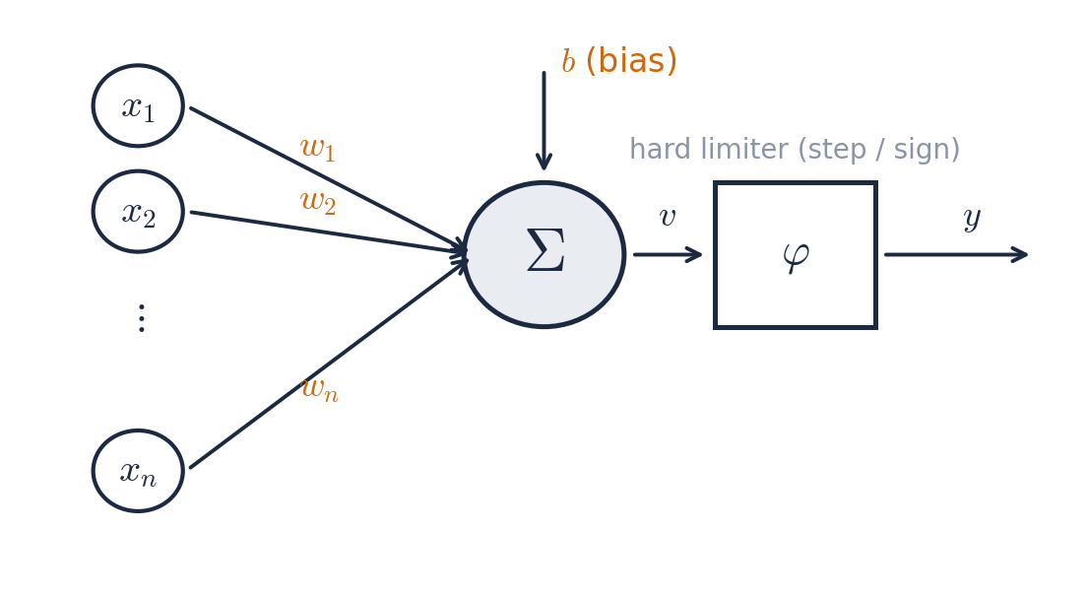
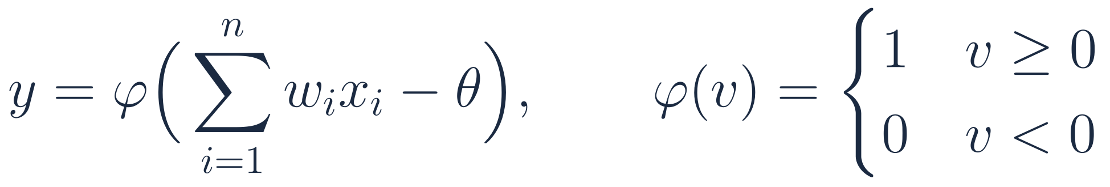
The artificial neuron (McCulloch–Pitts → Rosenblatt)
Weighted sum → threshold → binary decision
b_{i}
Inputs x₁…xₙ are real numbers (features); each has a weight wᵢ that says how much it matters and in which direction.
The bias b shifts the decision point; without it every boundary must pass through the origin.
The activation φ is a hard limiter: the neuron either fires (1 / +1) or not (0 / −1).
Learning = choosing w and b from labelled examples (x, t).

Slide 3
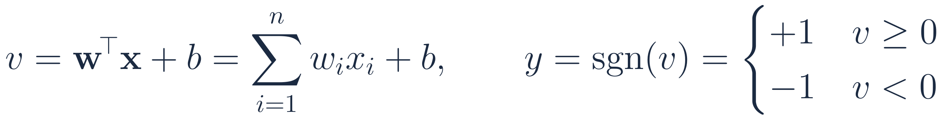
Perceptron: definition and the augmented-vector trick
We use the bipolar convention t, y ∈ {−1, +1} for the theory; the AND example later uses {0, 1}
Absorb the bias into the weights
Vocabulary you must be fluent in
v — induced local field / net input / pre-activation
y — actual output; t (or d) — target / desired output
e = t − y — error signal
η (eta) — learning rate, a small positive constant
epoch — one full pass over all training samples
Prepend a constant input x₀ = 1 whose weight is b.
Then every formula has only w and x — the bias is updated by the same rule as any weight.
This is why some textbooks never mention b at all.

Slide 4
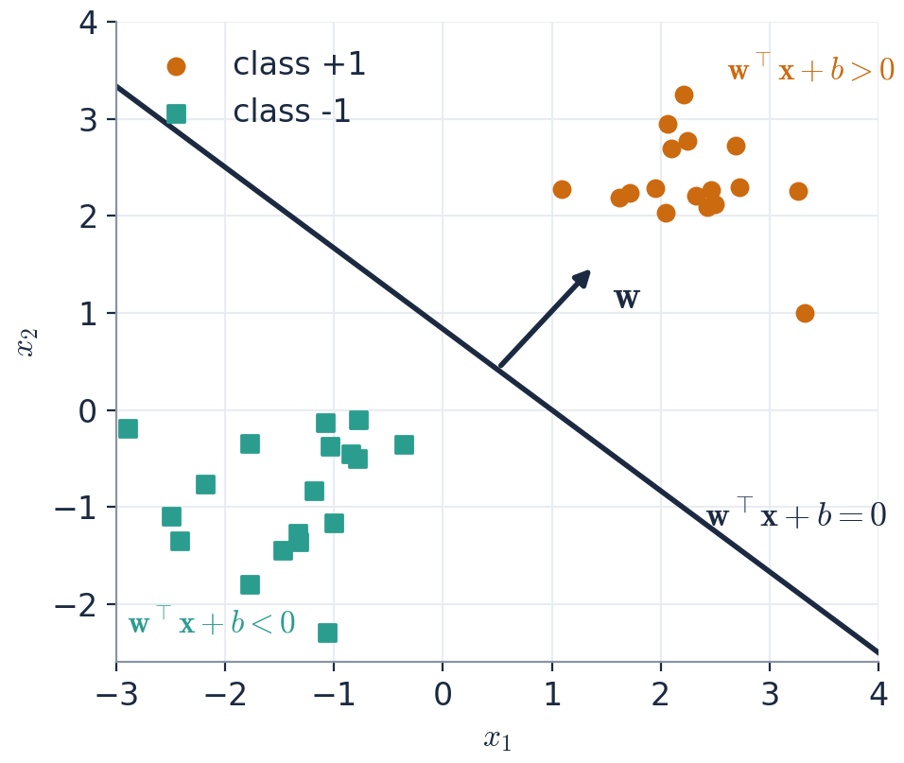
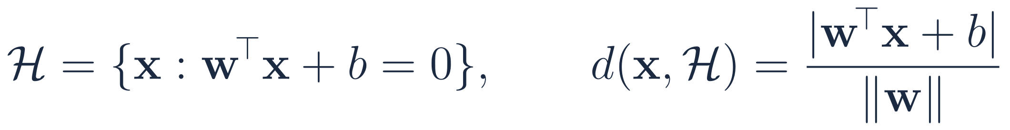
Geometry: the perceptron is a hyperplane
w is the normal vector; b sets the offset; the sign tells which side you are on
In 2-D the boundary wᵀx + b = 0 is a line; in 3-D a plane; in n-D an (n−1)-dimensional hyperplane.
w is perpendicular to the boundary and points toward the +1 side (because moving along w increases wᵀx).
The signed distance of a point to the boundary is (wᵀx + b)/‖w‖ — so |v| measures how confidently a point is classified.
Scaling w and b by the same positive constant does NOT change the boundary — only the direction of w̃ matters.

Slide 5
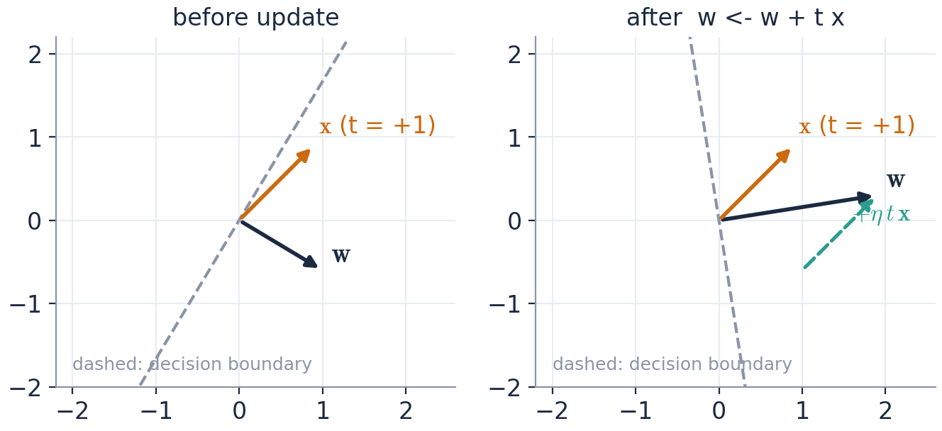
The perceptron learning rule (Rosenblatt)
Error-correction: change nothing when right; when wrong, move w toward (or away from) x
Why does it work? (bipolar case, t − y ∈ {0, ±2})
Correct sample: t = y ⇒ (t − y) = 0 ⇒ no change. The rule only reacts to mistakes.
Missed positive (t = +1, y = −1): w ← w + 2ηx. New field: (w + 2ηx)ᵀx = wᵀx + 2η‖x‖² — strictly larger, i.e. pushed toward the correct (+) side.
False positive (t = −1, y = +1): w ← w − 2ηx. The field decreases by 2η‖x‖².
Geometrically: w rotates toward a misclassified positive x and away from a misclassified negative x (figure, left).
η only scales the step; for the perceptron η = 1 is fine because only the direction of w̃ matters.

Slide 6
The algorithm, step by step
Online / sample-by-sample training with a stopping test
1
Initialise
w = 0 (or small random values), b = 0; choose η > 0.
Pseudo-code
repeat
errors ← 0
for k = 1 … N:
v ← w·x[k] + b
y ← 1 if v ≥ 0 else 0
if y ≠ t[k]:
w ← w + η (t[k] − y) x[k]
b ← b + η (t[k] − y)
errors ← errors + 1
until errors = 0
2
Present a sample (xₖ, tₖ)
Compute v = wᵀxₖ + b and y = φ(v).
3
Compare
If y = tₖ: do nothing. Else: w ← w + η(tₖ − y)xₖ, b ← b + η(tₖ − y).
4
Repeat for all samples
One pass over the training set = one epoch.
5
Stop
when an entire epoch produces no update (all samples correct) — or after a maximum number of epochs if the data are not separable.

Slide 7
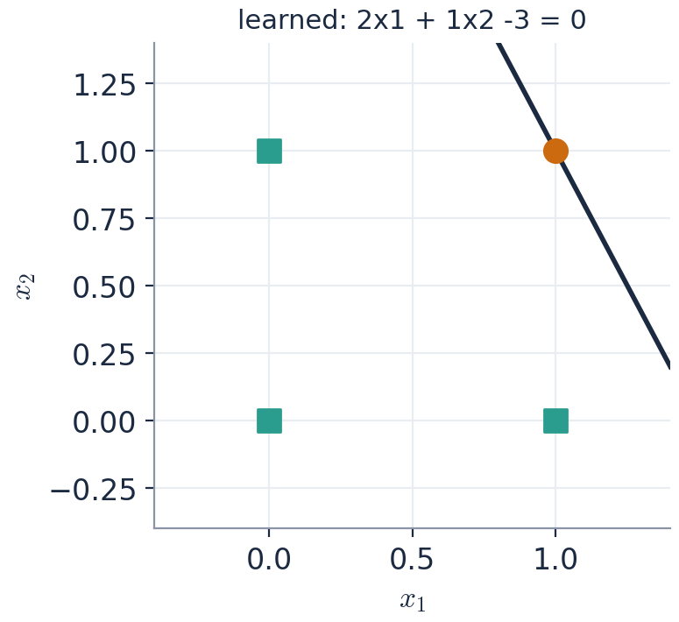
Worked example: learning the AND function
Unipolar targets t ∈ {0,1}; φ(v) = 1 if v ≥ 0 else 0; w = (0,0), b = 0, η = 1
epoch | x | t | w (before) | b | v | y | t − y | w (after) | b (after)
1 | (0, 0) | 0 | (0, 0) | 0 | 0 | 1 | -1 | (0, 0) | -1
1 | (0, 1) | 0 | (0, 0) | -1 | -1 | 0 | 0 | (0, 0) | -1
1 | (1, 0) | 0 | (0, 0) | -1 | -1 | 0 | 0 | (0, 0) | -1
1 | (1, 1) | 1 | (0, 0) | -1 | -1 | 0 | 1 | (1, 1) | 0
2 | (0, 0) | 0 | (1, 1) | 0 | 0 | 1 | -1 | (1, 1) | -1
2 | (0, 1) | 0 | (1, 1) | -1 | 0 | 1 | -1 | (1, 0) | -2
2 | (1, 0) | 0 | (1, 0) | -2 | -1 | 0 | 0 | (1, 0) | -2
2 | (1, 1) | 1 | (1, 0) | -2 | -1 | 0 | 1 | (2, 1) | -1
Rows shaded amber are the mistakes — the only rows where w or b change (v = 0 counts as y = 1, so (0,0) is initially misclassified).
Continuing the same procedure, the first error-free epoch is epoch 6, ending with w = (2, 1), b = -3: the line 2x₁ + 1x₂ − 3 = 0 (figure, right).
Check: (1,1) → v = 0 → y = 1 ✓; (1,0) → v = −1 → 0 ✓; (0,1) → v = −2 → 0 ✓; (0,0) → v = −3 → 0 ✓.

Slide 8

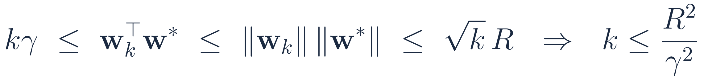
Perceptron convergence theorem
If a separating hyperplane exists, the algorithm finds one after finitely many updates
Proof (η = 1, w₀ = 0, bipolar targets, bias absorbed; count only the k updates, i.e. samples with tₖ wₖᵀxₖ ≤ 0)
1
Alignment with w* grows at least linearly (uses the margin γ):
2
The norm grows at most like √k (uses tₖwₖᵀxₖ ≤ 0 on an update and ‖xₖ‖ ≤ R):
3
Combine with Cauchy–Schwarz:
Remarks: the bound does not depend on n or on N; a small margin γ (points close to the boundary) means slow learning; if the data are NOT separable the algorithm never stops — you must cap the epochs.

Slide 9
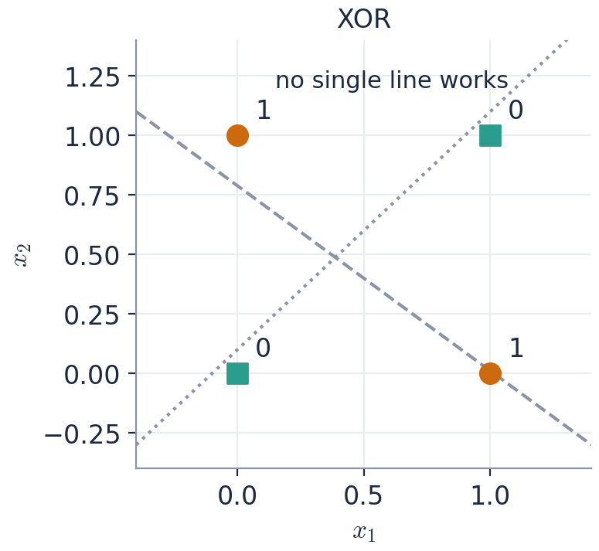
The limitation: only linearly separable problems
Minsky & Papert (1969) — the XOR function has no separating line
Proof that XOR is not separable
Suppose w₁x₁ + w₂x₂ + b ≥ 0 exactly for the points with t = 1, i.e. (0,1) and (1,0), and < 0 for (0,0) and (1,1).
Then w₂ + b ≥ 0 and w₁ + b ≥ 0 ⇒ w₁ + w₂ + 2b ≥ 0.
But b < 0 and w₁ + w₂ + b < 0 ⇒ w₁ + w₂ + 2b < 0. Contradiction.
Consequences
Of the 16 Boolean functions of two inputs, 14 are separable; XOR and XNOR are not.
In high dimensions (images, text) real classes are almost never linearly separable in the raw features.
Two ways out: (a) hand-craft nonlinear features (e.g. x₁x₂), or (b) let the network learn its own features with hidden layers → Part 2.
The 1969 critique froze neural-network research for ≈15 years (the first 'AI winter').

Slide 10
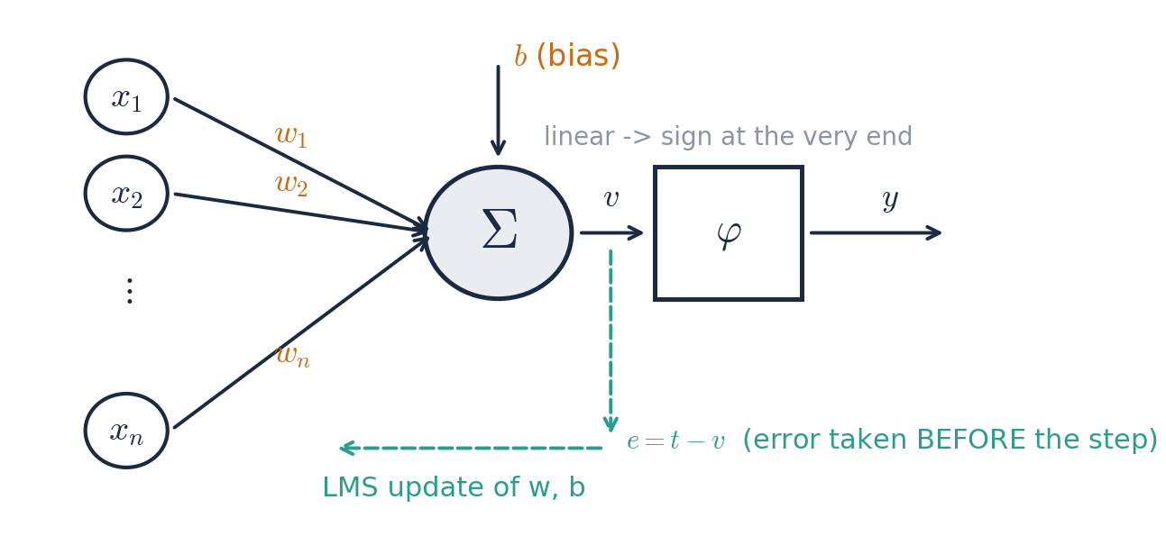
ADALINE : learn from the linear output
ADAptive Linear Element — same neuron, different learning signal
What changes compared with the perceptron
The perceptron's error t − y is quantised (0 or ±2): it knows THAT it was wrong, not by HOW MUCH.
ADALINE uses the continuous error e = t − v measured before the threshold, so a sample that is 'barely wrong' and one that is 'badly wrong' produce different corrections.
This makes the error a smooth, differentiable function of w — and we can use calculus (gradient descent).
The step function is still applied at the end to get a ±1 decision.
Historically it was implemented in hardware (memistors) and used in adaptive filters / echo cancellation — the LMS algorithm is everywhere in signal processing.

Slide 11
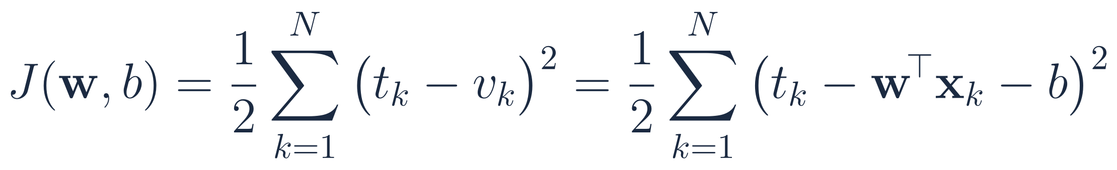
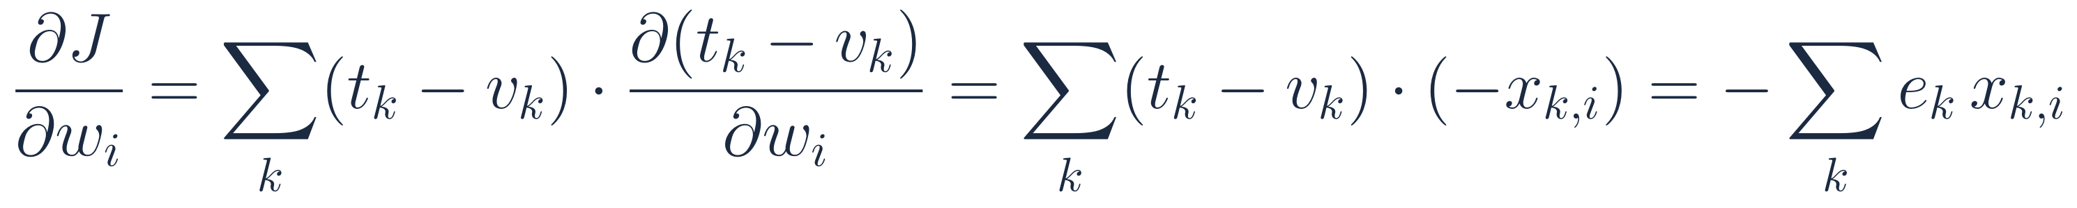
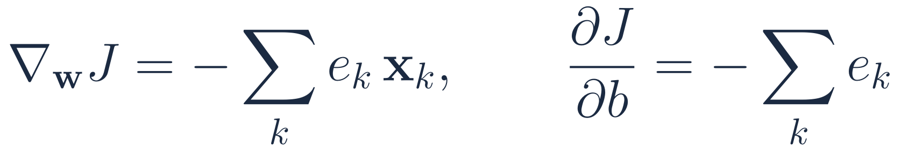
Cost function and its gradient — full derivation
Minimise the sum of squared errors over the training set
1
Define the cost (the ½ is there only to cancel the 2 from differentiation):
2
Differentiate with respect to one weight wᵢ (chain rule: outer square, inner linear term):
3
Collect all components into a vector (the bias behaves like a weight with input 1):
The gradient is minus the error-weighted sum of the inputs. Where the error is positive (output too small), the gradient points to smaller w, so stepping AGAINST the gradient increases w in the direction of x — exactly what raises v.

Slide 12
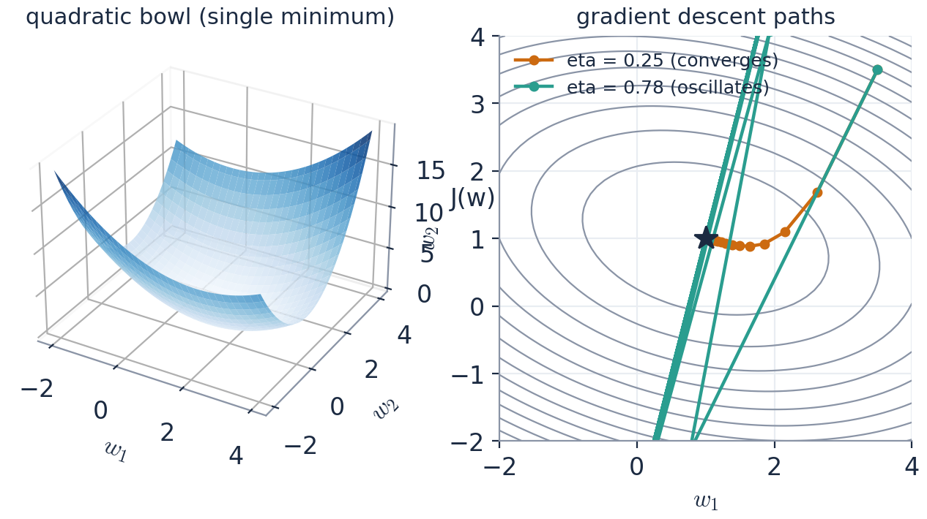
Gradient descent
Step downhill; batch uses all samples, LMS uses one sample at a time
Batch GD: exact gradient, one update per epoch, smooth descent.
LMS: uses the single-sample error as a noisy estimate of the gradient — cheaper, updates immediately, and is the ancestor of SGD.
Same shape as the perceptron rule Δw = η·(error)·x, but the error is now continuous — and the update happens even when the sign is already right.
The learning rate η matters here: too large ⇒ oscillation / divergence (teal path).

Slide 13
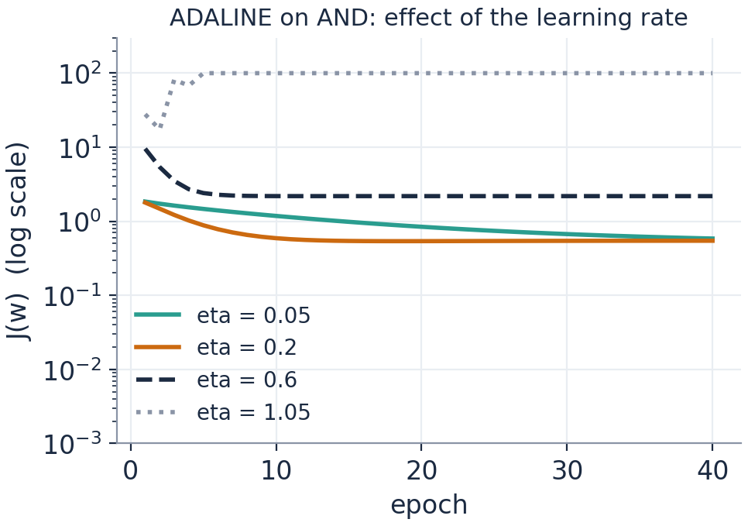
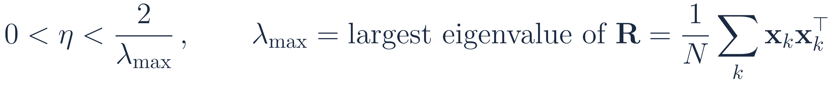
Choosing η, and the closed-form alternative
Why LMS still matters when the exact solution is one matrix inversion away
Stability
Convergence in the mean requires η below 2/λₘₐₓ, where λₘₐₓ is the largest eigenvalue of the input correlation matrix R.
Practical recipe: normalise inputs, start with η ≈ 0.01–0.1, halve it if J oscillates.
Figure: η = 0.05 slow, 0.2 good, 0.6 still converges, 1.05 diverges.
The normal equations (linear least squares)
Exact minimiser of J — but requires storing all data and inverting an (n+1)×(n+1) matrix.
LMS is O(n) per sample, works online, tracks slowly changing data — that is why it is used in adaptive filters.

Slide 14
Worked example: LMS on the AND data (bipolar targets)
t ∈ {−1,+1}; w = (0,0), b = 0, η = 0.2; update on every sample: w ← w + η e x, b ← b + η e
epoch | x | t | w (before) | b | v = wᵀx+b | e = t − v | w (after) | b (after)
1 | (0, 0) | -1 | (0, 0) | 0 | 0 | -1 | (0, 0) | -0.2
1 | (0, 1) | -1 | (0, 0) | -0.2 | -0.2 | -0.8 | (0, -0.16) | -0.36
1 | (1, 0) | -1 | (0, -0.16) | -0.36 | -0.36 | -0.64 | (-0.128, -0.16) | -0.488
1 | (1, 1) | 1 | (-0.128, -0.16) | -0.488 | -0.776 | 1.776 | (0.227, 0.195) | -0.133
2 | (0, 0) | -1 | (0.227, 0.195) | -0.133 | -0.133 | -0.867 | (0.227, 0.195) | -0.306
2 | (0, 1) | -1 | (0.227, 0.195) | -0.306 | -0.111 | -0.889 | (0.227, 0.017) | -0.484
2 | (1, 0) | -1 | (0.227, 0.017) | -0.484 | -0.257 | -0.743 | (0.079, 0.017) | -0.633
2 | (1, 1) | 1 | (0.079, 0.017) | -0.633 | -0.537 | 1.537 | (0.386, 0.325) | -0.325
Row 2: v = −0.2 (already the right sign) yet e = −0.8 ≠ 0 — ADALINE keeps pulling v toward the target value −1, not merely to the right side. The perceptron would have done nothing here.
After many epochs the weights approach the least-squares solution w = (1, 1), b = -1.5, whose boundary x₁ + x₂ = 1.5 sits centrally between the classes (compare the perceptron's arbitrary 2x₁ + x₂ = 3).
Exam tip: always show v, e and the update on the same line — most marks are for the arithmetic being traceable.

Slide 15
Perceptron vs ADALINE — side by side
Same neuron, same update template Δw = η · error · input; different error
 | Perceptron (1958) | ADALINE (1960)
Error signal | t − y, after the threshold (quantised) | t − v, before the threshold (continuous)
What is minimised | number of misclassifications (implicitly) | sum of squared errors J(w) — explicit cost
Update when correct? | never | yes, if v ≠ t (pulls v toward ±1)
Theory | converges in finite steps iff separable | gradient descent on a convex bowl; converges for small η even if NOT separable
Learning rate | irrelevant (only direction of w̃ matters) | critical: 0 < η < 2/λₘₐₓ
Solution found | any separating hyperplane | least-squares hyperplane (unique)
Non-separable data | never terminates | still gives the best linear fit
Legacy | SVM (maximum-margin perceptron), online learning | linear regression, adaptive filters, SGD, back-propagation

Slide 16
Check yourself
Try these before the break — answers in the speaker notes
1
A perceptron has w = (2, −1), b = −1. Classify x = (1, 2) and x = (2, 1). Sketch the boundary and mark the positive side.
2
Using the bipolar perceptron rule with η = 1, the sample x = (1, −1), t = +1 is misclassified by w = (0, 1), b = 0. Give the new w and b, and verify the induced field on x has increased.
3
Why does the perceptron convergence theorem not apply to XOR? What does the algorithm do on XOR data?
4
For ADALINE with w = (0.5, 0.5), b = 0, η = 0.1, sample x = (1, 1), t = −1: compute v, e and the updated parameters.
5
State one situation where you would prefer ADALINE/LMS over the exact least-squares solution.

Slide 17
Thank You

